Slide 1
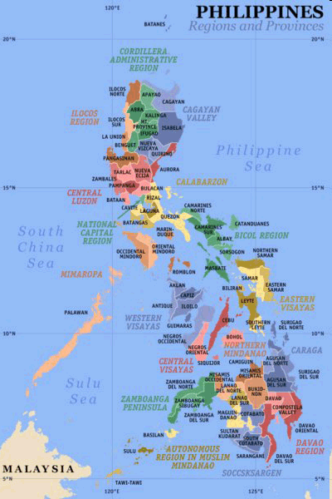

Presidents of the
Republic of the Philippines

Slide 2
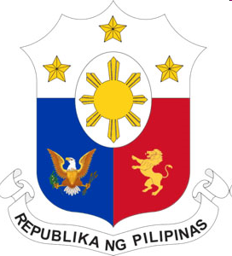
President of the Philippines
The President of the Philippines is the head of state and government of the Republic of the Philippines.
The executive power is vested in the President of the Philippines.
The President of the Philippines in Filipino is referred to as Ang Pangulo or Pangulo (or informally, "Presidente").

Slide 3
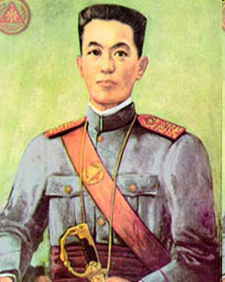
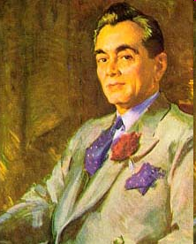
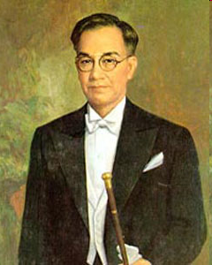
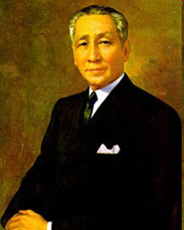
First Republic (Malolos Republic)
(First Dictatorship) (1899-1901)
  Emilio Aguinaldo (January 23, 1899-April 1, 1901)
Commonwealth (American Era) (1935-1944)
  Manuel L. Quezon (November 15, 1935 – August 1, 1944)
Second Republic (Japanese Occupation) (1943-1945)
  Jose P. Laurel (October 14, 1943 – August 14, 1945)(de facto)
Commonwealth (Restored) (1944-1946)
  Sergio Osmeña (August 1, 1944 – May 28, 1946)

Slide 4
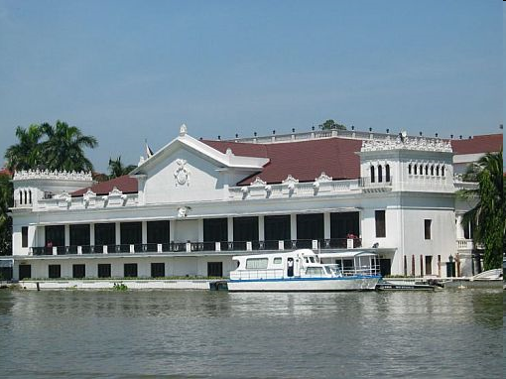
Third Republic
(Post-American Era) (1946-1972)

Slide 5
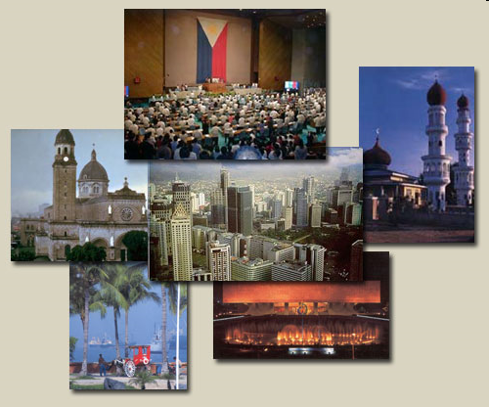
Challenges of Third Republic
After the war, the Commonwealth was restored pending complete independence. With independence from the US came the establishment of the Third Republic of the Philippines. The government of the independent Republic was riddled with graft and corruption and lost the confidence of the people. The corruption within the government also resulted in the rise of the Left in the form of the HUKBALAHAP or the Huks. The Huks presented even more problems to the Republic.

Slide 6
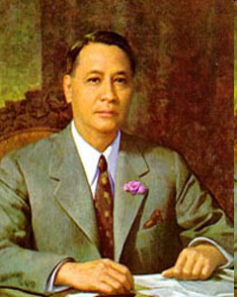
Manuel Acuna Roxas
Fifth President
First President of the Independent Third Republic of the Philippines
1946 - 1948
“If war should come, I am certain of one thing–probably the only thing of which I can be certain–and it is this: That America and the Philippines will be found on the same side, and American and Filipino soldiers will again fight side by side in the same trenches or in the air or at sea in the defense of justice, freedom and other principles which we both loved and cherished.”
(May 28, 1946 – April 15, 1948)
He was inaugurated on July 4, 1946, the day the U.S. government granted political independence to its colony.
Nacionalista (1919–1945)
Liberal Party (1945–1948)

Slide 7
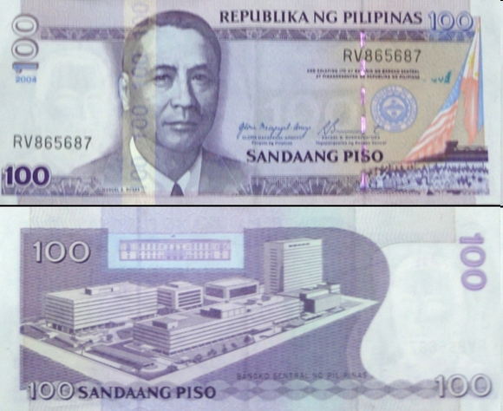
Biography
was born in Capiz (now Roxas City)
studied law at UP and graduated with honors in 1913.
he topped the Bar examinations in 1913,
was employed as private secretary to Chief Justice Cayetano Arellano
taught law in 1915-1916.
started in politics when appointed as a member of the Capiz municipal council.
In 1919, he was elected as governor of Capiz.
elected as congressman in 1922 and became House Speaker
1935, he was chosen as a delegate to the Constitutional Convention.
Serve also as Secretary of Finance under Quezon’s Administration
elected as a senator in 1941 and eventually became Senate President
he was also a reserve Major in the Philippine Army, a liaison officer and aide-to-camp to General Douglas MacArthur, then later promoted to Colonel and then Brigadier General.
Achievements
greatest achievements, namely: the ratification of the Bell Trade Act; the inclusion of the Parity Amendment in the Constitution; and the signing of the 1947 Military Bases Agreement
Rehabilitation and reconstruction of war-ravanged Philippines
Improvement of the ruined economy
Adopted the pro-American policy.
Problems
Graft and corruption in the government, as evidenced by the “Surplus of War Property Scandal”, “Chinese Immigration Quota Scandal”, “School Supplies Scandal:
Failure to check the Communist HUK movement.

Slide 8
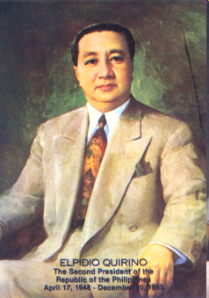
Elpidio Rivera Quirino
Sixth President
Second President of the Third Republic
1948 - 1953
“While I recognise the United States as a great builder in this country, I have never surrendered the sovereignty, much less the dignity and future of our country.”
— Elpidio Quirino[
Significant Event
Two Asian heads of state visited Philippines–President Chiang Kai-shek of Nationalist China (Formosa) in July 1949 and President Achmed Sukarno of Indonesia in January 1951.
On May 26-30, 1950, upon Quirino's invitation seven free Asian nations held the Baguio Conference of 1950 to discuss common problems of Asian peace and security.
Korean War and over 7,450 Filipino soldiers were sent to Korea under the designation of the Philippine Expeditionary Forces to Korea or PEFTOK
(November 16, 1890 – February 29, 1956)

Slide 9
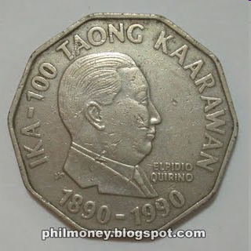
Early life and career
born in Vigan, Ilocos Sur to Don Mariano Quirino of Caoayan and Dona Gregoria Mendoza Rivera of Aringay
spent his early years in Aringay, La Union.
spent his elementary education to his native, Caoayan, Ilocos Sur and were he became a barrio teacher.
He received secondary education at Vigan High School
worked as junior computer in the Bureau of Lands and as property clerk in the Manila police department.
graduated from Manila High School in 1911 and also passed the civil service examination, first-grade.
attended the University of the Philippines. In 1915, he earned his law degree from the university's College of Law, and was admitted to the bar later that year.
engaged in the private practice of law
  Early Political Career
elected as member of the Philippine House of Representatives from 1919 to 1925,
Senator from 1925 to 1931
Secretary of Finance and Secretary of the Interior in the Commonwealth government.
In 1934, a member of the Philippine Independence mission to Washington D.C., headed by Manuel L. Quezon that secured the passage in the United States Congress of the Tydings-McDuffie Act.
After the war, Quirino continued public service, becoming president pro tempore of the Senate.
In 1946, he was elected first vice president of the independent Republic of the Philippines, serving under Manuel Roxas. He also served as secretary of state.

Slide 10
Problems
Lack of Funds
HUK Problem: Terrorism and Disruption of Peace and order.
Graft and corruption in his government, as revealed in theTambobong-Buenavista scandal, the Import Control Anomalies, the Caledonia Pile Mess and the Textbook Racket;
Wasteful spending of the people's money in extravagant junkets abroad;
Failure of government to check the Huk menace which made travel in the provinces unsafe, as evidenced by the killing of former First Lady Aurora Quezon and her companions on April 21, 1949 by the Huks on the Bongabong-Baler road, Baler, Tayabas (no part of Aurora province).
Economic distress of the times, aggravated by rising unemployment rate, soaring prices of commodities, and unfavorable balance of trade. Quirino's vaunted "Total Economic Mobilization Policy" failed to give economic relief to the suffering nation.
Frauds and terrorism committed by the Liberal Party moguls in the 1947, 1949 and 1951 elections.
Two main objectives of his administration:
the economic reconstruction of the nation
the restoration of the faith and confidence of the people in the government.
  Creation of PACSA: President’s Action Committee on Social Amelioration
  Creation of ACCFA: Agricultural Credit Cooperatives Financing Administration
  Excellence in Foreign Relations.

Slide 11
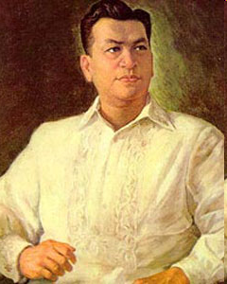
Ramon del Fierro Magsaysay
Seventh President
Third President of the Third Republic
1953 - 1957
“The office of the President is the highest in the land. It can be the humblest also, if we regard it — as we must — in the light of basic democratic principles. The first of these principles is the declaration of the Constitution that "sovereignty resides in the people and all government authority emanates from them." This simply means that all of us in public office are but servants of the people.”
He is known as president of the masses.
(August 31, 1907 - March 17, 1957)
He was sworn into office wearing the Barong Tagalog, a first by a Philippine president.
During his term, he made Malacañáng Palace literally a "house of the people", opening its gates to the public.
He was killed in a plane crash before the end of his term.

Slide 12
Early life
born in Iba, Zambales on August 31, 1907 to Exequiel Magsaysay, a blacksmith, and Perfecta del Fierro, a schoolteacher.
He entered the University of the Philippines in 1927.
He worked as a chauffeur to support himself as he studied engineering; later
transferred to the Institute of Commerce at Jose Rizal College (1928-1932), where he received a baccalaureate in commerce.
He then worked as automobile mechanic and shop superintendent.
he joined the motor pool of the 31st Infantry Division of the Philippine army during WW2.
Congressman under Pres Roxas’ Administration and serve as Chairman of the House National Defense Committee
Secretary of National Defense during Pres Quirino’s Administration
Achievements
Agrarian Reform
established the National Resettlement and Rehabilitation Administration (NARRA) to resettle dissidents and landless farmers. It was particularly aimed at rebel returnees providing home lots and farmlands in Palawan and Mindanao.
Savior of democracy in the Philippines
Man of the Masses
Stopped the HUK communist rebellion
Improved the conditions of the barrios
Constructed roads, bridges, irrigation canals
Established the SEATO: Southeast Asia
Treaty Organization
Imposed high moral standard for public
officials
Problems
Impending projects
Lack of enough funds
Graft and corruption

Slide 13
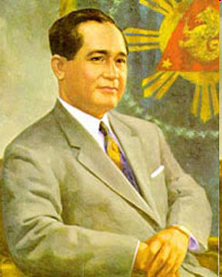
Carlos Polistico Garcia
Eight President Fourth
President of the Third Republic
1957 - 1961
“As a people, we prize highly the moral and spiritual values of life. But the realities of the moment have made us more preoccupied with economic problems chiefly concerning the material values of national life.”
known for his "Filipino First" policy, which put the interests of the Filipino people above those of foreigners and of the ruling party.
(November 4, 1896 – June 14, 1971)
was a Filipino teacher, poet, orator, lawyer, public official, and guerrilla leader.

Slide 14
Early Life
born in Talibon, Bohol to Policronio García and Ambrosia Polestico
his father serving as a municipal mayor for four terms.
primary education in Talibon,
secondary education in Cebu Provincial High School.
took law courses at Silliman University in Dumaguete City.
studied in Philippine Law School (now Philippine College of Criminology) and earned his degree in 1923. He was among the top ten in the bar examination.
he worked as a teacher for two years at Bohol Provincial High School.
became famous for his poetry in Bohol, where he earned the nickname "Prince of Visayan Poets" and the "Bard from Bohol".
1925-1931 as Congressman of Third District of Bohol
1931-1946 governor of Bohol. He served as provincial governor for two terms.
He became a member of the congress in 1946, and was elected three times to the senate for three consecutive terms from 1941 to 1953.
Garcia was the running mate of Ramon Magsaysay in the presidential election of 1953.
He was appointed Secretary of Foreign Affairs by President Ramon Magsaysay, for four years concurrently serving as vice-president.
Significant events in their term:
He assumed the presidency the day after Ramon Magsaysay's death. After Garcia finished Magsaysay's term, he was elected president in his own right.
President Garcia is most remembered most for his Austerity Program and Filipino First Policy. His Austerity Program was aimed at curbing graft and corruption within the government.
Problems during his Presidency:
Although it was not very successful, it did help to restore trust between the people and the government.
He was among the founders of the Association for Southeast Asia (1963)
He was the precursor of the Association for Southeast Asian Nations (ASEAN).

Slide 15

Successes of each President after their term:
The Filipino First Policy put the rights of Filipinos above those of foreigners (This favored the Filipino businessmen in contrast to foreign investors. This meant, foreigners could invest capital up to 40% in a business or industry while the remaining 60% would be owned by Filipino citizens.)
Garcia's policies aimed at boosting the economy and obtaining greater economic independence. Garcia also aimed at reviving old Filipino cultural traditions which might have become extinct as the result of the adoption of Spanish and American cultures through colonization.
Problems
Graft and corruption
Lack of treasury funds
Huge national debt
Impending projects
Garcia ran for president again in the 1961 elections but lost to Vice-President Diosdado Macapagal. On June 1, 1971, Garcia was elected delegate of the 1971 Constitutional Convention and chosen as president. He died two weeks later from a heart attack.

Slide 16
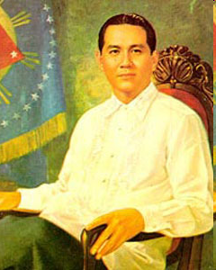
Diosdado Pangan Macapagal
Ninth President
Fifth President of the Third Republic
1961 - 1965
“Our first mission is the solution of the problem of corruption. We assume leadership at a time when our nation is in the throes of a moral degeneration unprecedented in our national history.”
"Poor boy from Lubao"
"The Incorruptible"
Diosdado Macapagal is of royal blood due to descent from their great-great-grandfather: Don Juan Macapagal (A prince of Tondo) who was a great-grandson of the last reigning Rajah of Selurong, Rajah Lakandula.
(September 28, 1910 – April 21, 1997)

Slide 17
Early Life
born on September 28, 1910 in Lubao, Pampanga
graduating valedictorian at Lubao Elementary School, and salutatorian at Pampanga High School.
He finished his pre-law course at the University of the Philippines, then enrolled at Philippine Law School in 1932, studying on a scholarship and supporting himself with a part-time job as an accountant.
topping the 1936 bar examination with a score of 89.95%
After passing the bar examination, Macapagal was invited to join an American law firm as a practicing attourney, a particular honor for a Filipino at the time.[
Master of Laws degree in 1941, a Doctor of Civil Law degree in 1947, and a Ph.D. in Economics in 1957.
Political Career
legal assistant to President Manuel L. Quezon and President Jose P. Laurel in Malacañang Palace.
After the war, Macapagal worked as an assistant attorney with the one of the largest law firms in the country, Ross, Lawrence, Selph and Carrascoso.
President Manuel Roxas appointed him to the Department of Foreign Affairs as the head of its legal division.
In 1948, President Elpidio Quirino appointed Macapagal as chief negotiator in the successful transfer of the Turtle Islands in the Sulu Sea from the United Kingdom to the Philippines.
That same year, he was assigned as second secretary to the Philippine Embassy in Washington, D.C. In 1949, he was elevated to the position of Counselor on Legal Affairs and Treaties, at the time the fourth highest post in the Philippine Foreign Office.
He first won election in 1949 to the House of Representatives,representing a district in his home province of Pampanga.
In 1957 he became vice president in the administration of President Carlos P. Garcia

Slide 18
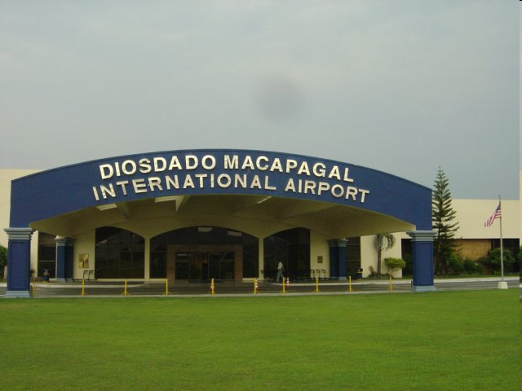
Presidency
During his term, Macapagal fought to suppress graft and corruption within the government and also tax evasion.
He also aimed to stimulate the economy and placed the peso in the free currency-exchange market, encouraging the wealthiest families to invest.
Macapagal also passed the Land Reform Bill which freed many farmers from slavery as tenant farmers.
Another of his achievements was the forming of Maphilindo (Malaysia, the Philippines and Indonesia) through a foreign policy. This paved the way for the creation of the Association of Southeast Asian Nations (ASEAN).
It was Macapagal who changed the Independence Day to June 12 from July 4.The first celebrations commemorating independence from Spain were held in 1962.
Among the most significant achievements of Macapagal as president were the abolition of tenancy and accompanying land reform program in the Agricultural Land Reform Code of 1963.
In 1971, he was elected president of the constitutional convention that drafted what became the 1973 constitution.
Problems
Acute problem in unemployment
Widespread mass poverty
Graft and corruption problem
Lack of treasury funds
a number his reforms were blocked by the Nacionalista dominated Senate and House of Representatives.

Slide 19
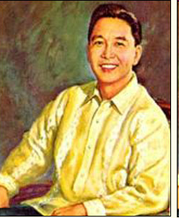
Ferdinand Emmanuel
Edralin Marcos
Tenth President
Sixth President of the Third Republic
1965-1986
“This nation can be great again. This I have said over and over. It is my articles of faith, and Divine Providence has willed that you and I can now translate this faith into deeds.”
in 1949, he said:
“Elect me your congressman now and I’ll give you an Ilokano President in 20 years.”
(September 11, 1917 – September 28,1989)
It is generally known that Marcos had the most infrastructure and constitutional accomplishments, which were equivalent to those of all former presidents of the Philippines.

Slide 20
Early life and career
born on September 11, 1917, in Sarrat, Ilocos Norte
named after Ferdinand VII of Spain and baptized into the Philippine Independent Church.
a champion debater at the UP;also participated in boxing, swimming and wrestling.
1939-cum laude with a law degree from the U.P. College of Law; was elected to the Pi Gamma Mu international honor society.
passed the bar examination with one of the highest scores in history, while also writing an 800-page defense.
1941-serve as part of military against Japanese and became one of the victim of Bataan Death March
Plans for economic development and good government/ Achievements
First term (1965-1969)
immediate construction of roads, bridges and public works, which included 16,000 kilometers of feeder roads, some 30,000 lineal meters of permanent bridges,
a generator with an electric power capacity of one million kilowatts (1,000,000 kW),
water services to eight regions and 38 localities.
revitalization of the judiciary, the national defense posture and the fight against smuggling, criminality, and graft and corruption in the government.
mobilized the manpower and resources of the Armed Forces of the Philippines (AFP) for action to complement civilian agencies
hired technocrats and highly educated persons to form part of the cabinet and
It was during his first term that the North Diversion Road (now, North Luzon Expressway) was constructed with the help of the AFP engineering construction battalion.
Vietnam War; over 10,450 Filipino soldiers were sent to South Vietnam under the designation of PHLCAAG or Philippines Civil Affairs Assistance Group.
Early political career
Congressman for 3 terms
Senator; served as minority floor leader before gaining the Senate presidency.
established a record for having introduced a number of significant bills, many of which found their way into the republic's statute books

Slide 21
Second Term 1969-1972
reelected because of his impressive performance
In 1969, the Philippines experienced higher inflation rate and devaluation of the Philippine peso.
the oil-producing Arab countries decided to cut back oil production, in response to Western military aid to Israel in the Arab-Israeli conflict, resulting in higher fuel prices worldwide.
The communal violence in Mindanao resulted in 100,000 refugees, burning of hundred of homes, and the death of hundreds of Christians and Muslims in Cotabato and Lanao.
an economic crisis brought by external and internal forces, a restive and radicalized studentry demanding reforms in the educational system, a rising tide of criminality, subversion by the re-organized Communist movement, and secession in the south.
On August 21, 1971, following the bombing of the Liberal Party proclamation rally in Plaza Miranda, President Marcos issued Proclamation No.889 suspending the privilege of the writ of habeas corpus.
Martial law and the New Society
“It is easier perhaps and more comfortable to look back to the solace of a familiar and mediocre past. But the times are too grave and the stakes too high for us to permit the customary concessions to traditional democratic processes.”
— Ferdinand Marcos, January 1973
Marcos declared martial law on September 21, 1972, by virtue of Proclamation No. 1081. Marcos, ruling by decree, curtailed press freedom and other civil liberties, closed down Congress and media establishments, and ordered the arrest of opposition leaders and militant activists
constitutional convention in 1970 to replace the colonial 1935 Constitution.The new constitution went into effect in early 1973, changing the form of government from presidential to parliamentary and allowing Marcos to stay in power beyond 1973.

Slide 22
Third Term (1981-1986)
“Fourth Republic”
“We love your adherence to democratic principles and to the democratic process, and we will not leave you in isolation.”
—U.S. VP George H. W. Bush during Ferdinand Marcos inauguration, July 1981
June 16, 1981, six months after the lifting of martial law, the first presidential election in twelve years was held. As to be expected, President Marcos ran and won a massive victory over the other candidates
In 1983, Benigno Aquino, Jr. was assassinated at the Manila International Airport upon his return to the Philippines after a long period of exile. This coalesced popular dissatisfaction with Marcos and began a succession of events, including pressure from the United States.
The Philippine economy suffered a great decline after the Aquino assassination in August 1983.
The political troubles also hindered the entry of foreign investments, and foreign banks stopped granting loans to the Philippine government.
the economy experienced negative economic growth beginning in 1984 and continued to decline despite the government's recovery efforts.
rampant graft and corruption within the government and by Marcos' lack of credibility.
Marcos himself diverted large sums of government money to his party's campaign funds.
The unemployment rate ballooned from 6.30% in 1972 to 12.55% in 1985.
Downfall
rampant corruption
political mismanagement by his relatives and cronies
having looted billions of dollars from the Filipino treasury
notorious nepotist, appointing family members and close friends to high positions in his cabine
The Philippine government today is still paying interests on more than US$28 billion public debts incurred during his administration.
Marcos's health deteriorated rapidly due to kidney ailments
Marcos called a snap presidential election for 1986, with more than a year left in his term.
the final tally of the National Movement for Free Elections, an accredited poll watcher, showed Aquino winning by almost 800,000 votes. However, the government tally showed Marcos winning by almost 1.6 million votes.
Popular sentiment in Metro Manila sided with Aquino, leading to a massive, multisectoral congregation of protesters, and the gradual defection of the military to Aquino led by Marcos' cronies, Enrile and Ramos.
The "People Power movement" drove Marcos into exile, and installed Corazon Aquino as the new president.

Slide 23
VI. Energy Self-Reliance
Indigenous energy sources were developed like hydro, geothermal, dendrothermal, coal, biogas and biomass.
VII. Export Development
During 1985 textile and textile products were exported
VIII. Labor Reform
The Labor code was promulgated which expanded the concerns of the Magna Carta of Labor to extend greater protection to labor, promote employment, and human resource development.
IX. Unprecedented Infrastructure Growth
The country’s road network had improved from 55,778 kilometers in 1965 to 77,950 in five years (1970), and eventually reached 161,000 kilometers in 1985.
X. Political Reform
The structure of government established by President Marcos remains substantially the same except the change of name, inclusive of superficial features in laws, to give a semblance of change from that of President Marcos regime.
XI. Fiscal Reform
Government finances were stabilized by higher revenue collections and loans from treasury bonds, foreign lending institutions and foreign governments.
XII. Peace and Order
In 1966, more than 100 important smugglers were arrested; in three years 1966-68 they arrested a total of 5,000. Military men involved in smuggling were forced to retire. Peace and order significantly improved in most provinces however situations in Manila and some provinces continued to deteriorate until the imposition of martial law in 1972.
Legacy
I. Food sufficiency
A. Green Revolution
Production of rice was increased through promoting the cultivation of IR-8 hybrid rice.
B. Blue Revolution
Marine species like prawn, mullet, milkfish, and golden tilapia were being produced and distributed to farmers at a minimum cost.
C. Liberalized Credit
More than one thousand rural banks spread all over the country resulting to the accessibility of credit to finance purchase of agricultural inputs, hired labor, and harvesting expenses at very low interest rate.
D. Decontrol Program
Price control polices were implemented on rice and corn to provide greater incentive to farmers to produce more.
II. Education Reform
The literacy rate climbed from 72% in 1965 to 93% in 1985 and almost 100% in Metro Manila on the same year.
III. Agrarian Reform
Tenant’s Emancipation Act of 1972 or PD 27 was the first Land Reform Code of our country.
IV. Primary Health Care
The Primary Health Care (PHC) Program made medical care accessible to millions of Filipinos in the remotest barrios of the country.
V. Housing for the masses
Bagong Lipunan Improvement of Sites and Services (BLISS) Housing project had expanded the government’s housing program for the low-income group.

Slide 24
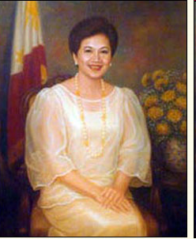
Maria Corazon "Cory" Sumulong Cojuangco Aquino
Eleventh President of the Philippines
First Female President
First President of Fifth Republic
1986-1992
First elected female head of state in Asia
Best remembered for leading the 1986 EDSA People Power Revolution, which toppled the authoritarian regime of the late strongman Ferdinand Marcos and restored democracy in the Philippines
“Icon of Democracy”
(January 25, 1933 – August 1, 2009)

Slide 25
EDUCATION
Elementary and Secondary
• St. Scholastica's College
• Ravenhill Academy in Philadelphia, United States
• Notre Dame Convent School in New York
College
• Bachelor of Arts, College of Mount Saint Vincent in New York (1953)
• Doctor of Humanities, honoris causa, College of Mount Saint Vincent, New York, Ateneo de Manila University, Xavier University (Philippines)
• Doctor of Humanities, honoris causa, University of Boston, Fordham University, Waseda University (Tokyo), Far Eastern University, and University of Sto. Tomas
• Honoris Causa, Stonehill College (Massachusetts)
born on January 25, 1933 to Jose Cojuangco of Tarlac, a wealthy Chinese Filipino and Demetria Sumulong of Antipolo, Rizal, an ethnic Filipina who belongs to a politically influential clan
Married to late Sen. Benigno “Ninoy” Aquino
The couple produced five offsprings, four girls and one boy, namely: Maria Elena (Ballsy), Aurora Corazon(Pinky), Benigno Simeon III (NoyNoy), Victoria Eliza (Viel) and Kristina Bernadette (Kris)
Declared herself as a plain housewife
Led the 1986 People Power Revolution
Established Presidential Commission on Good Government (PCGG) during her presidency
issued Proclamation No. 3, which established a revolutionary government
Family Code of 1987, Administrative Code of 1987 (reorganized the structure of the executive branch of government ), 1991 Local Government Code
Economic Management and Agrarian Reform as her top agenda as president

Slide 26
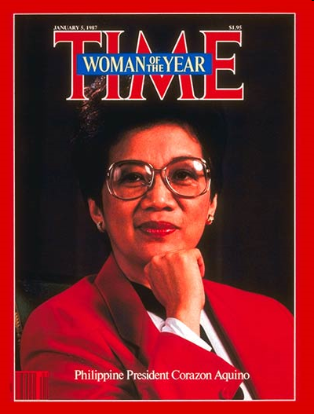
IMPORTANT NOTES IN HISTORY
-Agreed to run for president against Marcos in the February 7, 1986 Snap Election after her supporters gathered a million signatures.
-Installed as the President of the Republic of the Philippines on February 25, 1986 because of the historic People's Power which stripped Marcos of power.
-Took oath under Supreme Court Justice Claudio Teehankee as President of the Philippines at Club Filipino.
-Implemented a program of reconciliation and freed political prisoners like Bernabe Buscayno of the New People's Army and Jose Maria Sison of the Communist Party of the Philippines.
-Retained the presidential form of government.
-Under her reign,a national plebiscite was held to ratify the amendments to the 1935 Constitution on February 2, 1987,
Named Woman of the Year by Time Magazine.
-Awarded the Gawad Eleanor Roosevelt for Human Rights
-Her popularity waned because of the people around her who wanted to exact vengeance on Marcos.
-Six coup d' etat aimed at overthrowing her government took place during her reign, the two bloodiest of which took place in 1987 and 1989.
-The country went through great problems and calamities during her reign like the earthquake of, July 16, 1990; Typhoon Rufing and increase in the price of oil due to the Middle East War and
the eruption of Mount Pinatubo in 1991.

Slide 27
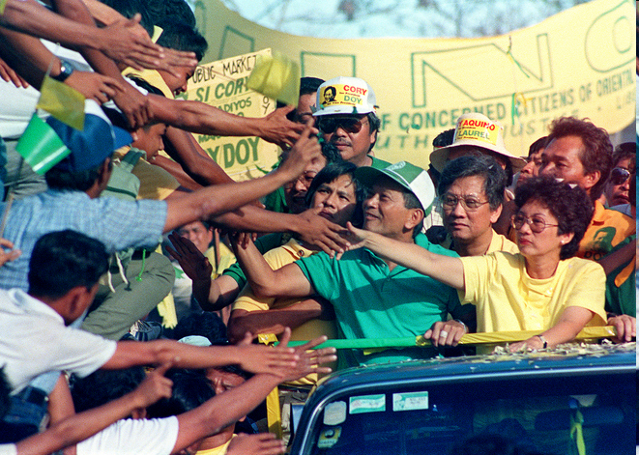
Problems as President
Natural disasters and calamities
nine coup attempts against her administration
graft and corruption
failure of the land reform
rising prices
inadequate essential public service
economic decline
Awards and achievements
1986 Time Magazine Woman of the Year
1986 Eleanor Roosevelt Human Rights Award
1986 United Nations Silver Medal
1986 Canadian International Prize for Freedom
1986 Nobel Peace Prize nominee
1986 International Democracy Award from the International Association of Political Consultants
1987 Prize For Freedom Award from Liberal International
1993 Special Peace Award from the Aurora Aragon Quezon Peace Awards Foundation and Concerned Women of the Philippines
1994 One of 100 Women Who Shaped World History (by G.M. Rolka, Bluewood Books, San Francisco, CA)
1995 Path to Peace Award
1996 J. William Fulbright Prize for International Understanding from the U.S. Department of State
1998 Ramon Magsaysay Award for International Understanding
1998 Pearl S. Buck Award
1999 One of Time Magazine's 20 Most Influential Asians of the 20th Century
2001 World Citizenship Award
2005 David Rockefeller Bridging Leadership Awards
2005 One of the World's Elite Women Who Make a Difference by the International Women's Forum Hall of Fame
2006 One of Time Magazine's 65 Asian Heroes
2008 One of A Different View's 15 Champions of World Democracy
EWC Asia Pacific Community Building Award
Women's International Center International Leadership Living Legacy Award
Martin Luther King Jr. Nonviolent Peace Prize
United Nations Development Fund for Women Noel Award for Political Leadership

Slide 28
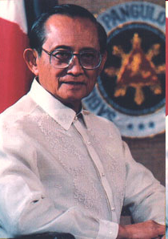
Fidel Valdez Ramos
Twelfth President
Third President of the Fifth Republic
“There are no easy tasks, no soft comforts for those chosen by circumstances to forge from the crucible of crisis the national destiny.”
Philippines 2000
Five-Point Program:
Peace and Stability
Economic Growth and Sustainable Development
Energy and Power Generation
Environmental Protection
Streamlined Bureaucracy
First Protestant President of the country
Only Filipino officer in history to have held every rank in the Philippine military from Second Lieutenant to Commander-in-Chief

Slide 29
Early Life
born March 18, 1928 in Lingayen, Pangasinan
He took his elementary education in Lingayen and secondary education at the University of the Philippines Integrated School and Centro Escolar University Integrated School
Philippine Military Academy as cadet and won a government scholarship to the United States Military Academy in West Point
Masters Degree in Civil Engineering in the University of Illinois at Urbana-Champaign, where he was a government scholar in 1951
licensed civil engineer in the Philippines, passing the board exams in 1953 and finishing in the top 10.
In 1960, he topped Special Forces-Psy Operations-Airborne course at the United States Army Infantry School at Fort Bragg, North Carolina
Master's Degree in National Security Administration from the National Defense College of the Philippines and a Master's in Business Administration (MBA) from the Ateneo de Manila University
2nd Lieutenant infantry platoon leader in the Philippine Expeditionary Forces to Korea (PEFTOK) in 1952 during the Korean War to Chief of Staff of the Philippine Civil Action Group to Vietnam from 1966 to 1968
instrumental in founding the Philippine Army Special Forces, an elite paratroop unit skilled in community development as well as fighting communist insurgents.
served the Marcos regime for more than 20 years. He was head of the Philippine Constabulary, the country's national police force, and was one of Marcos' trusted advisers, for which he was known as a member of the Rolex 12, an elite group of loyal to Marcos himself
Chief of Staff of the Armed Forces of the Philippines, and later Secretary of National Defense under Pres. Aquino

Slide 30
Programs
Power crisis- Ramos issued licenses to independent power producers (IPP) to construct power plants within 24 months
Economic reforms- (E-VAT law) from 4% to 10% mandated by World Bank and the International Monetary Fund; 'Philippines 2000'
Death penalty- In 1996 Ramos signed a bill that returned capital punishment with the electric chair
Peace with separatists- he signed into law Republic Act 7636, which repealed the Anti-Subversion Law. With its repeal, membership in the once-outlawed Communist Party of the Philippines became legal
Spratly Islands- starting to claim the Islands from China
Migrant Workers Protection- enactment of Republic Act 8042, better known as the Magna Carta for Overseas Workers or the Migrant Workers Act
Achievements
Philippine 2000
Southern Philippines Council for Peace and Development
ARMM
Peace Agreement with the MNLF
Increased foreign investments
APEC
Problems
Graft and Corruption problems
Economic Problems
High crime rate
Charter change
Clark Centennial Expo Scandal
PEA-Amari Scandal
Power crisis
Spratly Islands
Asian Financial Crisis

Slide 31
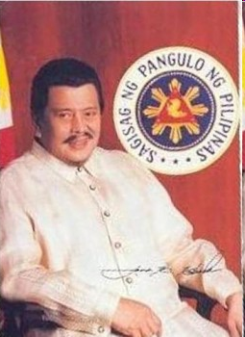
Joseph Ejercito Estrada
Thirteenth President
Third President of Fifth Republic
1998-2001
“One hundred years after Kawit, fifty years after independence, twelve years after EDSA, and seven years after the rejection of foreign bases, it is now the turn of the masses to experience liberation. We stand in the shadow of those who fought to make us free- free from foreign domination, free from domestic tyranny, free from superpower dictation, free from economic backwardness.”
Gained popularity as a film actor, playing the lead role in over 100 films in an acting career spanning 33 years

Slide 32

Early Life
Joseph Marcelo Ejercito, popularly known as Erap, was born on April 19, 1937 in Tondo, the poorest district of Manila
Ateneo de Manila University- high school;expeled because of unruly behavior
Mapúa Institute of Technology; engineering course, but dropped out from studies altogether two years later.
Began in Film at 20 years of age
first FAMAS Hall of Fame awardee for Best Actor (1981)
Hall of Fame award-winner as a producer (1983)
entered politics in 1967 when he ran for mayor of San Juan, a municipality of Metro Manila but proclaimed mayor in 1969, after winning an electoral protest against Dr. Braulio Sto. Domingo.
Senator; chairman of the senate committee on cultural minorities and passed a bill on commission on ancestral domain.
sponsored bills that were signed into law, namely, The Preservation of the Carabao (Republic Act no. 7307)The Construction of Irrigation Projects (Republic Act no. 6978)
Vice-President; chairman of the Presidential Anti-Crime Commission (PACC). Estrada arrested criminal warlords and kidnapping syndicates.

Slide 33
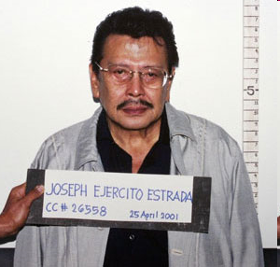
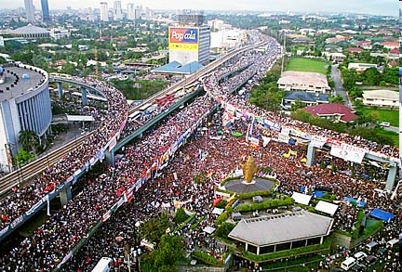
Programs
Domestic Policies
Agrarian Reform
The administration distributed more than 266,000 hectares of land to 175,000 landless farmers, including land owned by the traditional rural elite. (Total of 523,000 hectares to 305,000 farmers during his 2nd year as President)
Anti-Crime Task Forces
Executive Order No.8;creation of the Presidential Anti-Organized Crime Task Force (PAOCTF) with the objective of minimizing, if not totally eradicating, car theft and worsening kidnapping cases in the country
Charter Change
CONCORD or Constitutional Correction for Development; would only amend the 'restrictive' economic provisions of the constitution that is considered as impeding the entry of more foreign investments in the Philippines.
International Relations
strengthened bilateral ties with neighboring countries; Visiting Forces Agreement with the United States, which was ratified in the Senate
Economy
  The Estrada administration is said to have a strong economic team
War against the MILF
In 2000 he declared an "all-out-war" against the Moro Islamic Liberation Front and captured it's headquarters and other camps
Achievements
“Erap para sa Mahirap Project”
Problems
The Philippine Daily Inquirer; bias, malice and fabrication" against him
The Manila Times; libel suit against the country's oldest newspaper the Manila Times over a story that alleged corruption in the awarding of a public works project
BW Resources; BW Resources a small gaming company listed on the Philippine Stock Exchange and linked to people close to Estrada experienced "a meteoric rise"
Corruption charges and impeachment; allegations of corruption spawned an impeachment trial in the Senate, and in 2001 Estrada was ousted from power after the trial was aborted.

Slide 34
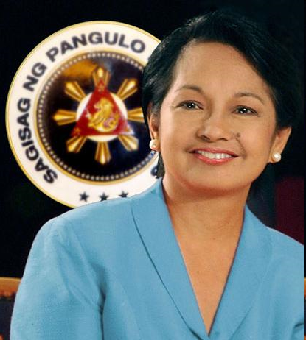
Maria Gloria Macapagal – Arroyo
Fourteenth President
Fourth President of the Fifth Republic
Second Female President
2001- Present
“I believe in leadership by example. We should promote solid traits such as work ethic and a dignified lifestyle, matching action to rhetoric, performing rather than grandstanding.”

Slide 35
Biography
Born on April 5, 1947; Daughter of former Pres. Diosdado Macapagal and Eva Macaraeg
Valedictorian, Elementary and Highschool at Assumption Convent, 1964
Magna Cum Laude, BA Economics at Assumption College, 1968
Consistent Dean’s List, Georgetown Univ.’s Walsh School of Foreighn Svc in Washington D.C. (Former US Pres Bill Clinton as classmate)
Professor of Economics 1977-1987
Master’s Degree in Economics ADMU 1978
Doctorate Degree in Economics UP 1985
Chairperson of Economics Dep’t. at Assumption College
1987, Asst. Sec of DTI
As Senator
Ranked as 13th and has 3 year term, 1992
Top in the election, 1995
400 bills, 55 sponsored or authored laws ( Anti-sexual harrasment Law, the Indigenous People’s Rights Law, Export Dev’t Act
As Vice President
Run under Lakas CMD with Jose de Venecia
Sen Edgardo angara as opponent
1st Female Vice President
Sec of DSWD (resigned in 2000 because of allegation against Pres. Estrada
President, 1st Term 2001-2004
“Strong Republic”
-strong bureaucracy
-lowering crime rates
-increasing tax collection
-improving economic growth
-intensifying counter-terrorism efforts
Became President through EDSA 2
Sworn as President by Chief Justice Hilario Davide Jr.
International community expressed that Arroyo with the church and business elites were an opportunist of post and planned well the coup
May 1, 2001 EDSA 3 against arroyo administration; Manila was declared in State of Rebellion

Slide 36
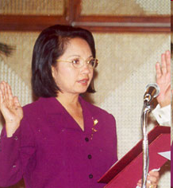
Oakwood Mutiny
July 27, 2003
Led by Lt. Antonio Trillanes IV, Army Capt. Gerardo Gambala of the Phil. Navy
Arroyo Administration was going to proclaim Martial Law and issue of corruption
2nd Term, 2004-Present
Dec 2002- Arroyo announced that she will not run for Pres in 2004 Election but 10 months after she reversed her decision.
2004 Presidential Election- FPJ, Ping Lacson, Raul Roco and Eddie Villanueva as her opponent
Issues as President after 2004 Election
  “Hello Garci Tape”
  State of Emergency under Proclamation No. 1017
  Manila Peninsula Rebellion
  NBN ZTE Deal
  -32 Satisfaction rate as of 1st quarter of 2009, lowest rate among the presidents
  Impeachment complaints
  Extra-judicial killings

Slide 37
President Gloria Macapagal-Arroyo's 10-point Agenda
The creation of six million jobs in six years via more opportunities given to entrepreneurs, tripling of the amount of loans for lending to small and medium enterprises and the development of one to two million hectares of land for agricultural business.
The construction of new buildings, classrooms, provision of desks and chairs and books for students and scholarships to poor families,
The balancing of the budget,
The "decentralization" of progress around the nation through the use of transportation networks like the roll-on, roll-off and the digital infrastructure,
The provision of electricity and water supply to barangays nationwide,
The decongestion of Metro Manila by forming new cores of government and housing centers in Luzon, Visayas and Mindanao,
The development of Clark and Subic as the best international service and logistic centers in the region,
The automation of the electoral process
A just end to the peace process, and
A fair closure to the divisiveness among the Edsa 1, 2 and 3 forces.
Programs
Economy- 5% GDP, highest percentage than 3 previous administartion
EVAT- economic reform agenda, Nov 2005
International Relations
  Philippine as No.1 ally of USA
  Foreign Policy is anchored on building strong ties with nations where OFW work and live
  RP as host of 12th ASEAN Summit in Cebu City
Domestic Relations
  Charter Change-federal parliamentary-unicameral form of government
  EO 464- forbidding gov’t officials w/0 Arroyo’s consent in congressional inquiries
  Estrada pardon last Oct 25, 2007

Slide 38
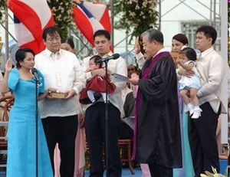
Awards / Commendations / Citations:
Magazine, Public Eye Magazine, Trade Union Congress of the Philippines, and by Emil Jurado (Manila Standard Columnist)
Woman of the Year, Catholic Education Association of the Philippines
Ulirang Ina, Ulirang Ina Awards Committee, 13 May 2001
One of Asia’s Most Powerful Women, Asiaweek
Making a Difference for Women – Women of Distinction Award, Soroptimist International of the Philippines Region, 30 May 2003
Most Distinguished Alumna, University of the Philippines Alumni Association (UPAA), 16 June 2001

